Slide 1
Lecture#9: GPIO Part#1 (Chapter#14) Summer, 2025
Embedded Systems with ARM Cortex-M Microcontrollers in Assembly Language and C
Credit: Dr. Mohammad A. Qayum

Slide 2
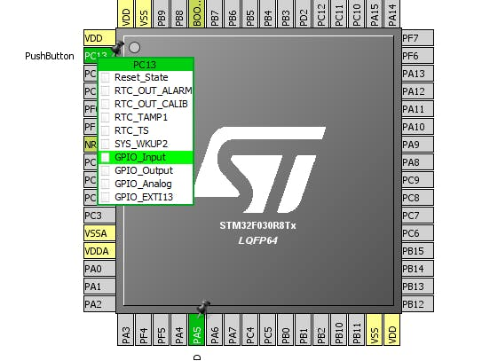
STM32F0 SOC map (ARM CORTEX-M0)

Slide 3
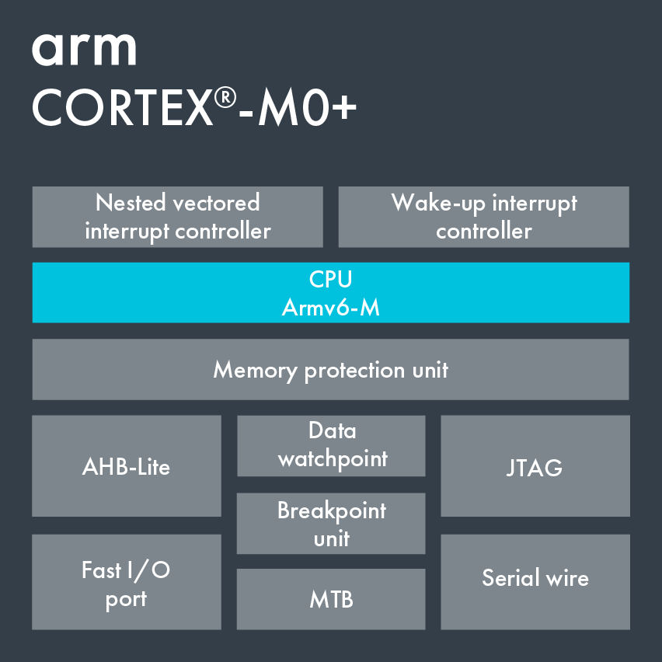
ARM CORTEX-M)+

Slide 4
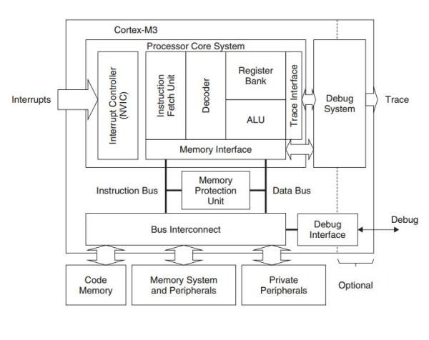
ARM Cortex-M3 architecture

Slide 5
Interfacing Peripherals
Port-mapped I/O
Use special CPU instructions: e.g. Port
Memory-mapped I/O
A simpler and more convenient way to interface I/O devices
Each device registers is assigned to a memory address in the address space of the microprocessor
Use native CPU load/store instructions: LDR/STR Reg, [Reg, #imm]
0x48000024
0x48000020
0x4800001C
0x48000018
0x48000014 | GPIO Data Output Register
0x48000010
Core
STR
Pin output
GPIO Output
Memory Space
ARM Cortex-M microprocessors use memory-mapped I/O.
Notes:
Usually, each on-chip peripheral device has a few registers, such as control registers, status registers, data input registers, and data output registers. In general, there are two approaches to exchange data between the processor core, and a peripheral device, including {{Pause=0.5}} port-mapped I/O, and {{Pause=0.5}} memory-mapped I/O. Port-mapped I/O uses special CPU instructions, which are designed specifically for I/O operations. {{Pause=0.5}} On the other hand, memory-mapped I/O does not need any special instructions. Each register is assigned to a memory address, in the memory address space of the microprocessor. Memory-mapped I/O is performed by the native load and store instructions of the processor. Therefore, memory-mapped I/O is a more convenient way to interface I/O devices.
Here is an example of memory mapped I/O. Suppose we want to set the output of a G P I O pin to high, software can use the store instruction STR to set the corresponding bit in G P I O data output register to 1. When you write to this “special memory location”, the data you write, is sent to, the corresponding I/O device. {{Pause=0.5}} ARM Cortex-M microprocessors use memory-mapped I/O.

Slide 6
Memory Map of Cortex-M4
0xFFFFFFFF
NVIC, System Timer, SCB, vendor-specific memory
System
0.5 GB
0xE0000000
External Device
1 GB
Such as SD card
0xA0000000
External RAM
1 GB
4 GB
Off-chip memory for data
0x60000000
Peripheral
0.5 GB
AHB & APB, such as timers, GPIO
0x40000000
SRAM
On-chip RAM, for heap, stack, & code
0.5 GB
0x20000000
0.5 GB
Code
On-chip Flash, for code & data
0x00000000
One Byte (8 bits)
Notes:
The memory address of ARM Cortex-M has a total of 32 bits, supporting 4 gigabytes of memory space. The memory space is divided into six different pre-defined regions. Each region is given for recommended usage. {{Pause=0.5}} The first region is code region. It is primarily used to store program code. It can also store data. The code region is on-chip memory, typically on-chip flash. The size of on-chip flash is limited to half a gigabyte. The actual size of the on-chip flash varies based on different venders and different chips. {{Pause=0.5}} The second region is SRAM. It is primarily used to store data, such as heaps and stacks. We can also put code here. It supports half a gigabyte. {{Pause=0.5}} The third region is peripheral. These peripherals include Advanced High Performance Bus peripherals, such as G P I O, and A D C, or Advanced Peripheral Bus peripherals, such as timers, and USART. {{Pause=0.5}} The next region is for external device, such as SD card. {{Pause=0.5}} The next is external RAM, which is executable region for data. It is off-chip memory, primarily used to store large data blocks. It has a total of 1 gigabyte. {{Pause=0.5}} The last region is system region, which includes the N V I C, system timer, system control block, and vendor-specific memory.

Slide 7
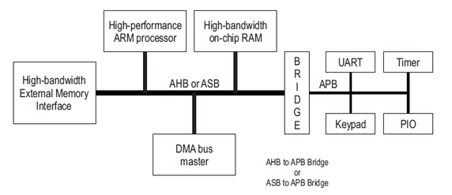
Advanced Microcontroller Bus Architecture (AMBA)
APB: Advanced Peripheral Bus
AHB: Advanced High-performance Bus
ASB: Advanced System Bus
MTB: Micro Trace Buffer
SCB: System Control Block

Slide 8
Memory Map of STM32L4
0xFFFFFFFF
System
0.5 GB
0xE0000000
External Device
1 GB
0xA0000000
0x60000000
External RAM
…
1 GB
0x48001000
GPIO D (1 KB)
0x60000000
Peripheral
0x48000C00
0.5 GB
GPIO C (1 KB)
0x40000000
0x48000800
SRAM
GPIO B (1 KB)
0.5 GB
0x48000400
0x20000000
GPIO A (1 KB)
0.5 GB
Code
0x48000000
…
0x00000000
0x40000000
One Byte (8 bits)
Notes:
{{Pause=0.5}} Let’s take a look at the peripheral region. This region covers the memory addresses of all on-chip peripherals, such as G P I O, timers, USART, S P I, and A D C. {{Pause=0.5}} Specific mapping addresses are dependent on vendors and chips. We will use G P I O on STM 32 L4 as an example to illustrate the concept of memory-mapped I/O. For instance, on STM 32 L4, the registers of G P I O Port A, are mapped to a small memory region starting at, 48000000 in hex.

Slide 9
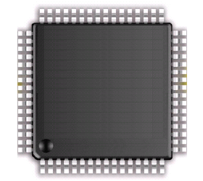
General Purpose Input/Output (GPIO)
Port E
8 GPIO Ports:
A, B, C, D, E, F, G, H
Up to 16 pins in each port
Port A
Port F
Port B
Port G
Port C
Port H
Port D
STM32L4
Notes:
{{Pause=2}} Each STM32L4 chip has eight G P I O ports, including port A, B, C, et cetera. Each G P I O port can have up to 16 pins. All pins in a G P I O port are controlled as a group. Each pin can be configured by software at runtime to perform various functions.

Slide 10
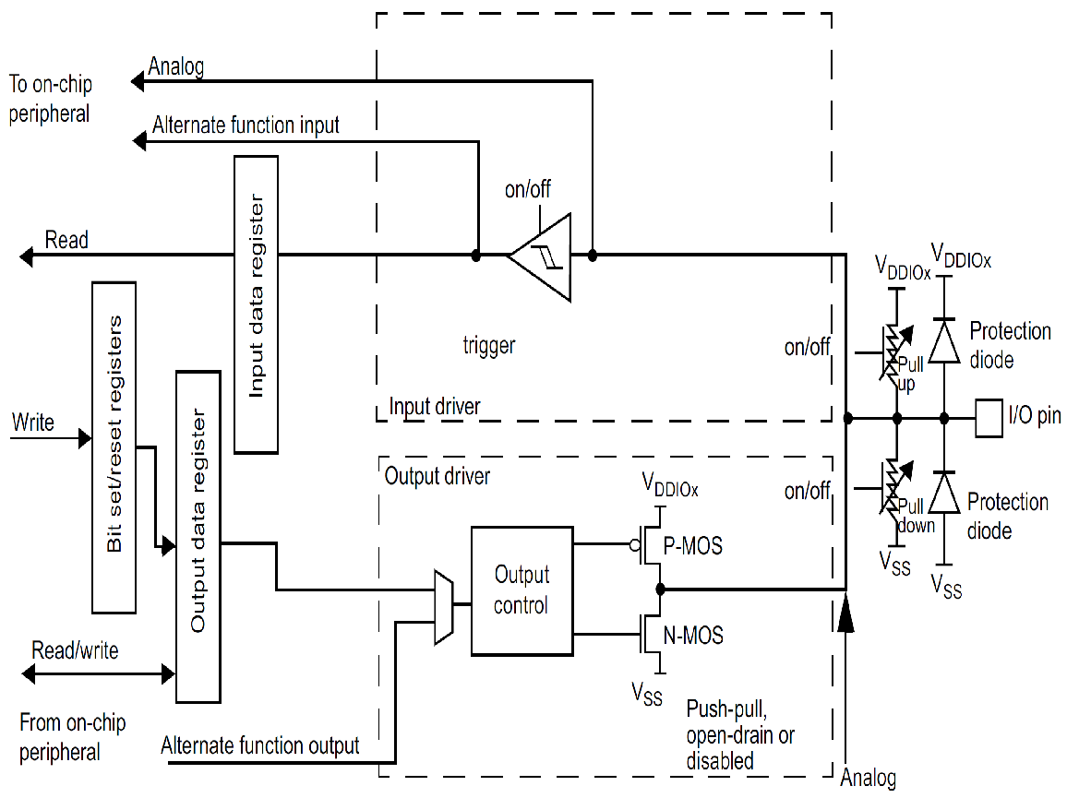
General Purpose Input/Output (GPIO)
D Bus
FLASH
ARM Cortex-M4
FPU
I Bus
AHB Bus Matrix
SRAM
S Bus
GPIO A
GPIO B
APB Bus Matrix
GPIO C
GPIO D
GPIO E
UART
GPIO F
GPIO G
SPI
GPIO H
Timer
…
STM32L4
Notes:
{{Pause=2}} The ARM Cortex-M4 processor core, is connected to the other components via three buses, include the data bus, the instruction bus, and the system bus. These buses are connected to the Advanced high performance bus (AHB) matrix. AHB is the backbone bus. It is used for high-performance, high clock frequency system modules, such as on-chip flash, on-chip SRAM, as well as G P I O modules. The chip also has a bridge that connects AHB to Advanced Peripheral Bus (APB). APB is for low bandwidth peripherals. APB connects most of the peripheral devices in the system, such as UART, S P I, and timer.
{{Pause=1}} Here is the basic structure of a G P I O module. I will explain the details of this module in the next slide.

Slide 11
General Purpose Input/Output (GPIO)
D Bus
FLASH
ARM Cortex-M4
FPU
I Bus
AHB Bus Matrix
SRAM
S Bus
GPIO A
GPIO B
APB Bus Matrix
GPIO C
GPIO D
GPIO E
UART
GPIO F
GPIO G
SPI
GPIO H
Timer
…
STM32L4
Notes:
{{Pause=2}} The ARM Cortex-M4 processor core, is connected to the other components via three buses, include the data bus, the instruction bus, and the system bus. These buses are connected to the Advanced high performance bus (AHB) matrix. AHB is the backbone bus. It is used for high-performance, high clock frequency system modules, such as on-chip flash, on-chip SRAM, as well as G P I O modules. The chip also has a bridge that connects AHB to Advanced Peripheral Bus (APB). APB is for low bandwidth peripherals. APB connects most of the peripheral devices in the system, such as UART, S P I, and timer.
{{Pause=1}} Here is the basic structure of a G P I O module. I will explain the details of this module in the next slide.

Slide 12
GPIO Memory Map
0x48000400
ASCR
0x4800002C
BRR
0x48000028
0x48000024
AFR[1]
AFR[0]
0x48000020
0x48000400
LCKR
GPIO A (1 KB)
0x4800001C
BSRR
48 bytes
0x48000000
0x48000018
0x48000014
ODR
IDR
0x48000010
PUPDR
0x4800000C
OSPEEDR
0x48000008
0x48000004
OTYPER
MODER
0x48000000
Each register has 4 bytes
Notes:
Let’s take a closer look at the memory map, for G P I O Port A. {{Pause=0.5}} Each port has 12 registers, and each register has 4 bytes. While a total of 1 kilobyte space is reserved for Port A, only 48 bytes are used. Within this 48-byte memory region, the G P I O mode register MODE R, is mapped to the lowest memory address, and the G P I O analog switch control register, A S C R, is mapped to the highest memory address.

Slide 13
GPIO Memory Map
0x48000400
Set pin A.14 to high
ASCR
0x4800002C
BRR
0x48000028
0x48000024
AFR[1]
AFR[0]
0x48000020
0x48000400
LCKR
GPIO A (1 KB)
0x4800001C
BSRR
48 bytes
0x48000000
0x48000018
0x48000014
ODR
IDR
0x48000010
PUPDR
0x4800000C
Set bit 14 of ODR to high
OSPEEDR
0x48000008
0x48000004
OTYPER
MODER
0x48000000
Notes:
Suppose we want to set the output of pin 14 of Port A to high. To achieve this, we need to set bit 14 of the output data register (ODR) of G P I O, A, to 1.

Slide 14
Output Data Register (ODR)
0x48000017
1 word (i.e. 32 bits)
ODR
0x48000014
0x48000017
0x48000016
4 bytes
0x48000015
0x48000014
Little Endian
31 | 30 | 29 | 28 | 27 | 26 | 25 | 24 | 23 | 22 | 21 | 20 | 19 | 18 | 17 | 16 | 15 | 14 | 13 | 12 | 11 | 10 | 9 | 8 | 7 | 6 | 5 | 4 | 3 | 2 | 1 | 0
Notes:
As discussed previously, each register has 32 bits, that is, 4 bytes. The output data register (ODR) of Port, A, on STM 32 L4, are mapped to the memory addresses from 48000014 to 48000017, in hex. If little endian is used, the highest memory address holds the most significant 8 bits, and the lowest memory address holds the least significant 8 bits.

Slide 15
Output Data Register (ODR)
0x48000017
1 word (i.e. 32 bits)
ODR
0x48000014
0x48000017
0x48000016
4 bytes
0x48000015
0x48000014
Little Endian
31 | 30 | 29 | 28 | 27 | 26 | 25 | 24 | 23 | 22 | 21 | 20 | 19 | 18 | 17 | 16 | 15 | 14 | 13 | 12 | 11 | 10 | 9 | 8 | 7 | 6 | 5 | 4 | 3 | 2 | 1 | 0
 |  |  |  |  |  |  |  |  |  |  |  |  |  |  |  |  | 1
*((uint32_t *) 0x48000014) |= 1UL<<14;
Dereferencing a pointer
Bitwise OR
Notes:
We use this C statement to set, bit 14, of ODR to 1, by using bitwise OR. This C statement also uses dereferencing to access the memory. Dereferencing a pointer means, getting the value that is stored in the memory location pointed by the pointer. The operator asterisk is used to do this. The asterisk is called the dereferencing operator. A sequence of load, modify, and store operations are performed in this statement. This statement casts the memory address to a memory pointer, which points to an 32-bit unsigned integer. First, the dereference operator retrieves the ODR register value, as a 32-bit unsigned integer. Then, a bit-wise operation is performed to modify this unsigned integer value. Finally, the updated value is stored back to the ODR register, via the dereferencing operation. However, directly dereferencing a numeric memory address, is inconvenient to use in practice. The code uses numeric addresses directly. Accordingly, it is not very readable. The next slide will present a new approach, which uses register names instead of memory addresses, thus greatly improving the code readability.

Slide 16
Dereferencing a Memory Address
ASCR
0x4800002C
BRR
typedef struct {
volatile uint32_t MODER; // Mode register
volatile uint32_t OTYPER; // Output type register
volatile uint32_t OSPEEDR; // Output speed register
volatile uint32_t PUPDR; // Pull-up/pull-down register
volatile uint32_t IDR; // Input data register
volatile uint32_t ODR; // Output data register
volatile uint32_t BSRR; // Bit set/reset register
volatile uint32_t LCKR; // Configuration lock register
volatile uint32_t AFR[2]; // Alternate function registers
volatile uint32_t BRR; // Bit Reset register
volatile uint32_t ASCR; // Analog switch control register
} GPIO_TypeDef;
// Casting memory address to a pointer
#define GPIOA ((GPIO_TypeDef *) 0x48000000)
0x48000028
0x48000024
AFR[1]
AFR[0]
0x48000020
0x4800001C
LCKR
BSRR
0x48000018
0x48000014
ODR
IDR
0x48000010
PUPDR
0x4800000C
OSPEEDR
0x48000008
0x48000004
OTYPER
MODER
0x48000000
GPIOA->ODR |= 1UL<<14;
or
(*GPIOA).ODR |= 1UL<<14;
Notes:
In memory-mapped I/O, all registers of a G P I O port, are mapped to a contiguous block of physical memory. This memory block can be represented by using a struct, as defined in this slide. A struct in C defines a physically grouped list of variables under one name. Note that we put volatile qualifier on each register. It informs the compiler that the variable might change spontaneously. When a variable is declared as volatile, the compiler is informed that even though no statements in the program appear to change it, the value might still change. Typically, compilers minimize the number of memory accesses, by storing the memory value in a register, and then repeatedly using it without accessing the memory. The volatile qualifier on a variable, prevents the compiler from making such optimization, on this variable.
{{Pause=0.5}} We use a macro definition here to give a name to the struct pointer. Let's name the macro G P I O A. {{Pause=0.5}} To set bit 14, we can use the membership operator to access the data output register ODR. We can either use the arrow operator, or the dot operator, to access the output data register ODR. These two C statements are equivalent. The asterisk G P I O A gets the structure that G P I O A points to.

Slide 17
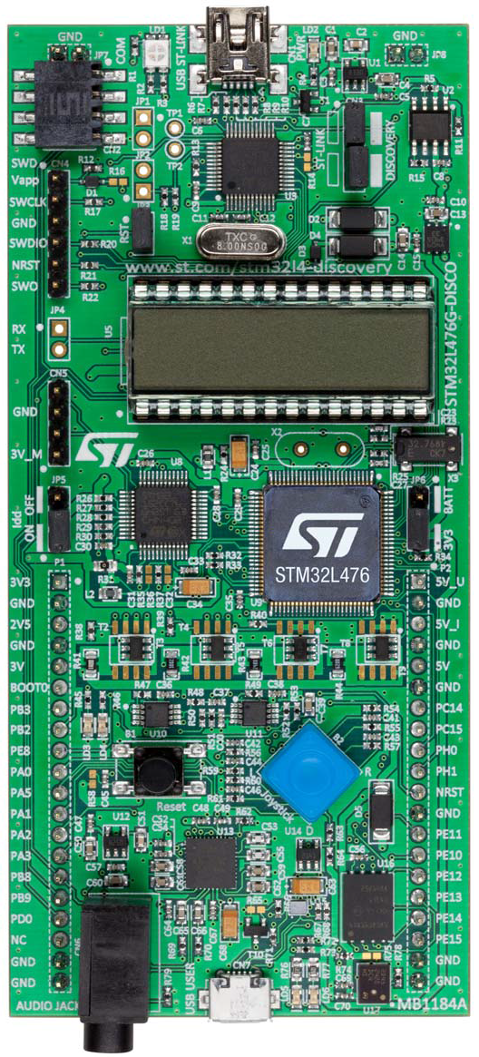
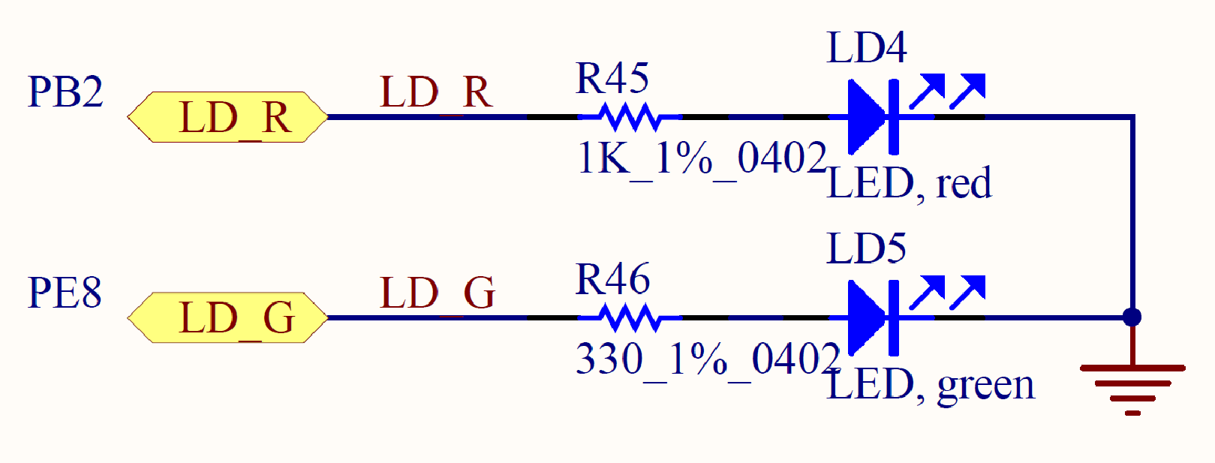
Red LED (PB.2)
STM32L4 Discovery Kit
PB.2
STM32L4
ARM
Cortex-M4
PE.8
PB.2 | Red LED
High | On
Low | Off
Red & Green LEDs
Notes:
{{Pause=2}} This is the STM32L4 discovery kit. Software can control two L E Ds on board, including one red LED, and one green LED. The red LED is connected to the microprocessor pin P B 2 via a resistor. The green LED is connected to the pin P E 8 via another resistor. In this tutorial, we only focus on lighting up the red LED. The process of lighting up the green LED is very similar. To turn on the red LED, software has to set the pin P B 2 to high. To turn off the red LED, software has to set the pin PB 2 to low. In this tutorial, I will show you how to set pin PB 2 to high.

Slide 18
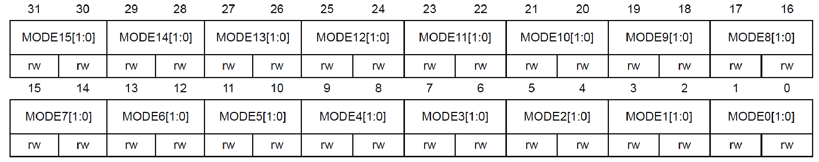
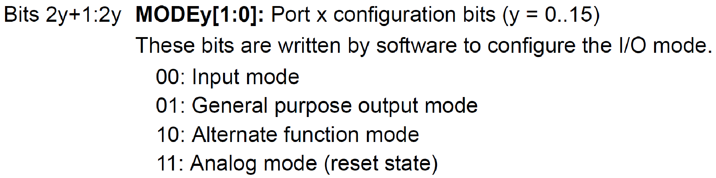
GPIO Mode Register (MODER)
32 bits (16 pins, 2 bits per pin)
Pin 2
Pin 1
Pin 0
GPIOB->MODER &= ~(3UL<<4); // Clear bits 4 and 5 for Pin 2
GPIOB->MODER |= 1UL<<4; // Set bit 4, set Pin 2 as output
Notes:
{{Pause=2}} Software can program each {{Pause=0.1}} G P I O pin as one of the following four different functions. First, digital input, which detects, whether an external voltage signal, is higher or lower than a predetermined threshold. Second, digital output, which controls the voltage on the pin. Third, analog functions, which perform digital-to-analog, or analog-to-digital conversion. Last, other complex functions, such as S P I data pin, and timer PWM output. We call the last category of functions as alternative functions. {{Pause=1}}
The function of a pin is controlled by the MODE register of this port. Each mode register has 32 bits. Port B has a total of 16 pins. The function of each pin is determined by two bits of the mode register. For example, bit 5 and bit 4 control the function of pin 2. When these two bits are zero zero, the pin is set as digital input. When these bits are zero one, this pin is used for digital output. When they are one zero, the pin has alternative function. Specific alternative function will be determined by the alternative function register of this port. When these two bits are one one, the pin will be used for analog-to-digital conversion (ADC), or digital-to-analog conversion (DAC). {{Pause=1}}
In this example, pin PB 2 will be used as output to turn on the red LED. Therefore, we need to set bit 5 and bit 4 to zero and one, respectively. {{Pause=2}} Here is the C code. First, we clear bit 4 and 5. Then we set bit 4 by using bitwise OR.

Slide 19
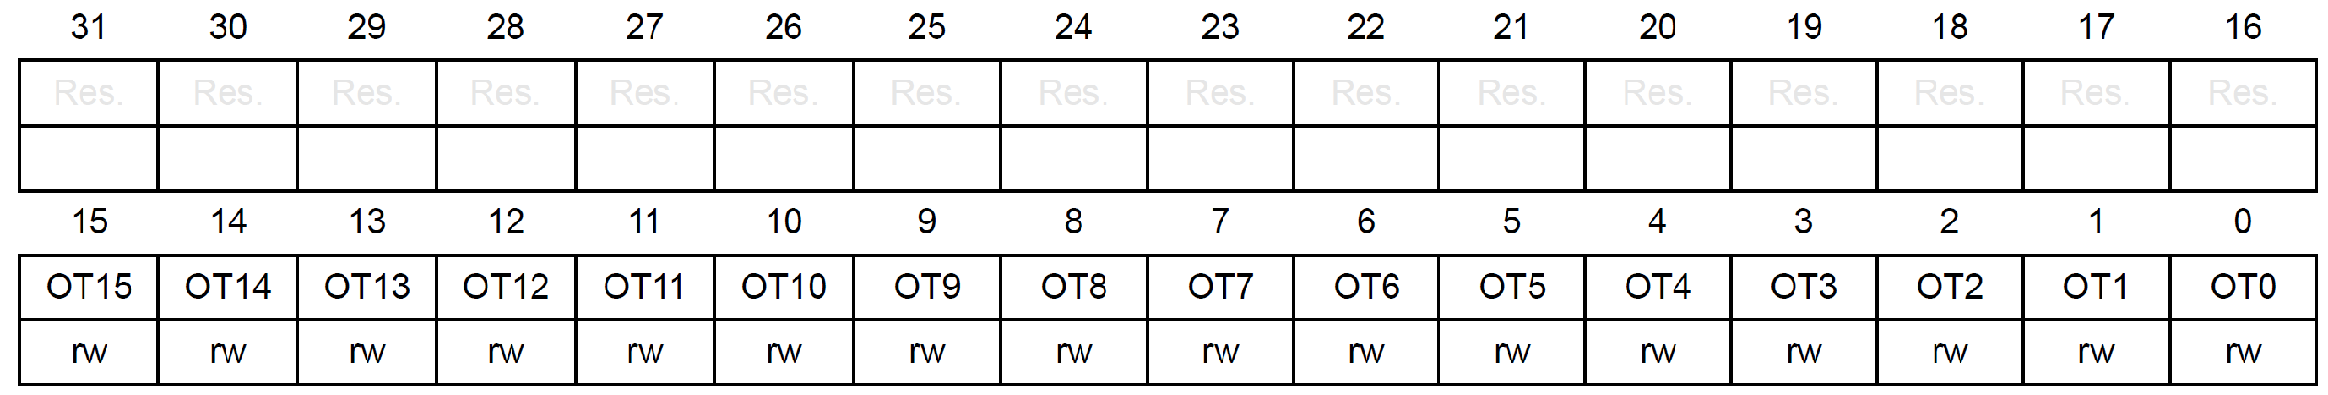
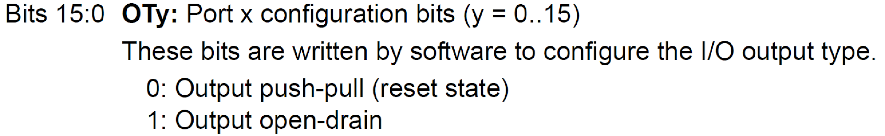
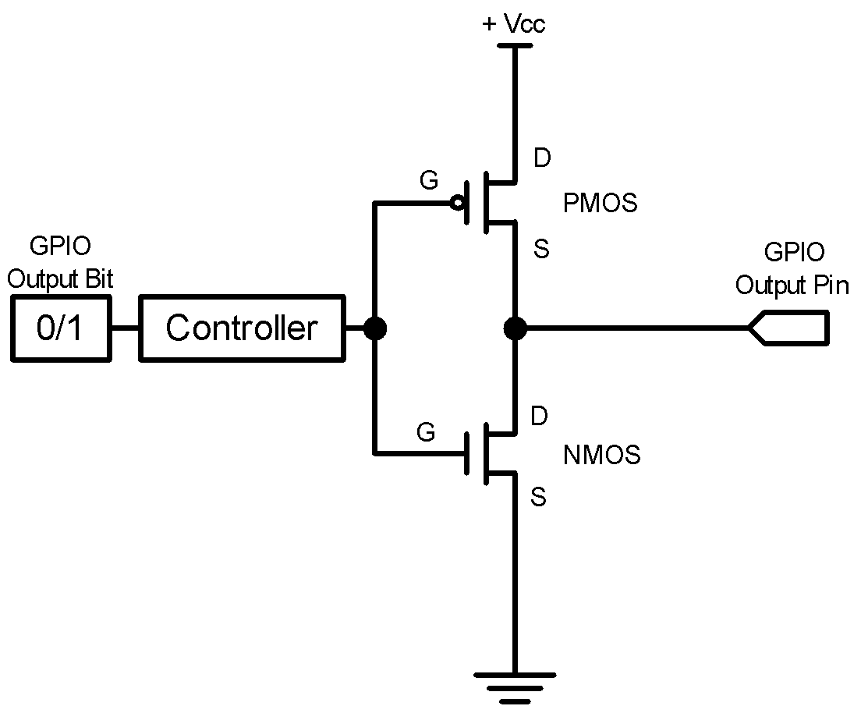
GPIO Output Type Register (OTYPE)
16 bits reserved, 16 data bits, 1 bit for each pin
GPIOB->OTYPE &= ~(1UL<<2); // Clear bit 2
Notes:
{{Pause=2}} Next, we need to set the output of mode of Pin 2 as push-pull, instead of open drain. Therefore, software has to clear bit 2 of the output type register. In the following few slides, I will explain what is the difference between push pull, and open drain.

Slide 20
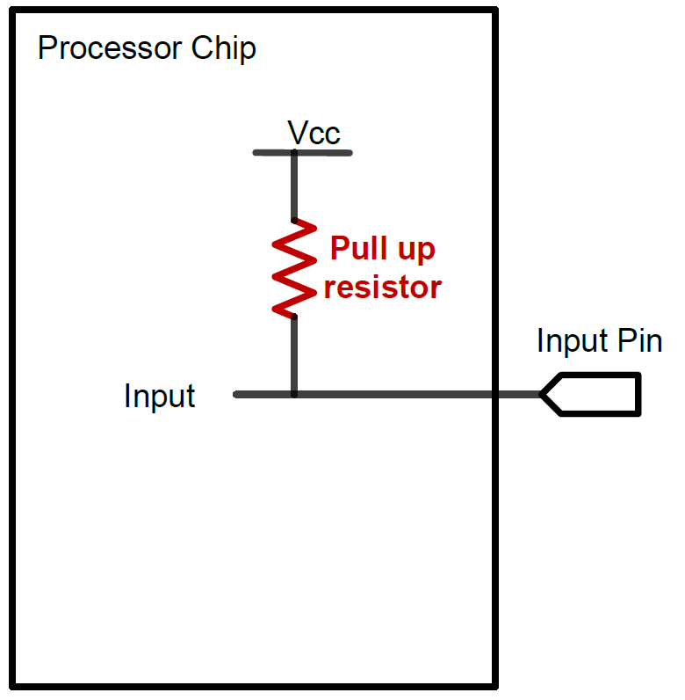
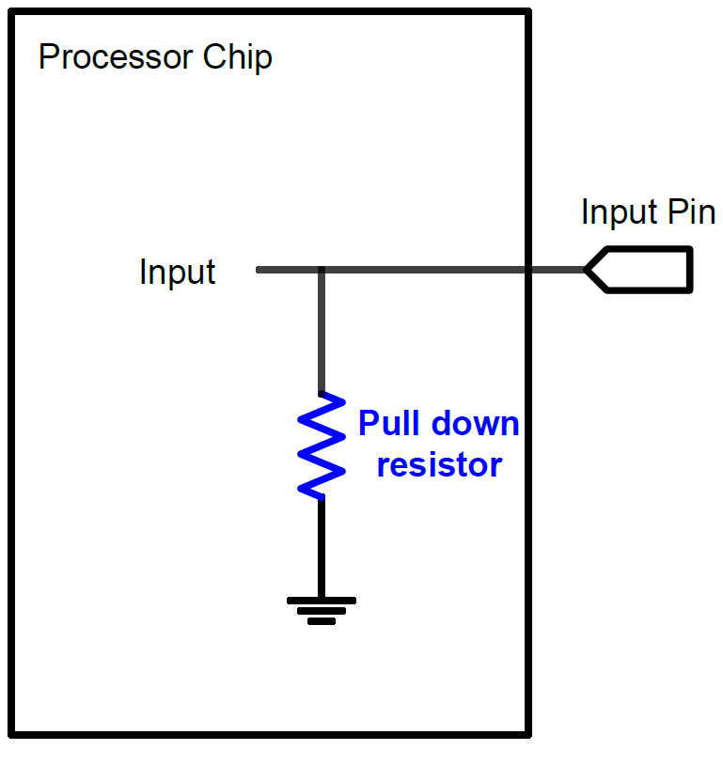
GPIO Input: Pull Up and Pull Down
A digital input can have three states: High, Low, and High-Impedance (also called floating, tri-stated, HiZ)
Pull-Up
Pull-Down
If external input is HiZ, the input is read as a valid HIGH.
If external input is HiZ, the input is read as a valid LOW.

Slide 21
Pullup and Pull down
When a G P I O pin is used for digital input, the default state of a pin can be high voltage, low voltage, or high impedance. The high impedance state is also called floating or tri-stated. Pull-up and pull-down are used to ensure the input pin has a valid input, either logic 1 or logic 0, when the external circuit does not drive the pin.
When a pin is configured as pull-down, the pin is then internally connected to the ground via a resistor. Similarly, when software configures a pin as pull-up, the pin is internally connected to the power supply via a resistor. When a pin is neither pulled up nor pulled down internally, then the pin has high impedance.
Note that the internal pull-up and pull-down resistors have large impedance, typically large than 10K ohms. When external circuit, connected to a G P I O pin, has a fair amount of capacitance, the process of, pulling the pin voltage to the level of logic high or logic low, takes a long time. This is because the impedance of, the internal pull-up and pull-down resistors, is too large. To meet the speed requirements, external pull-up or pull-down with small resistors, are often needed.

Slide 22
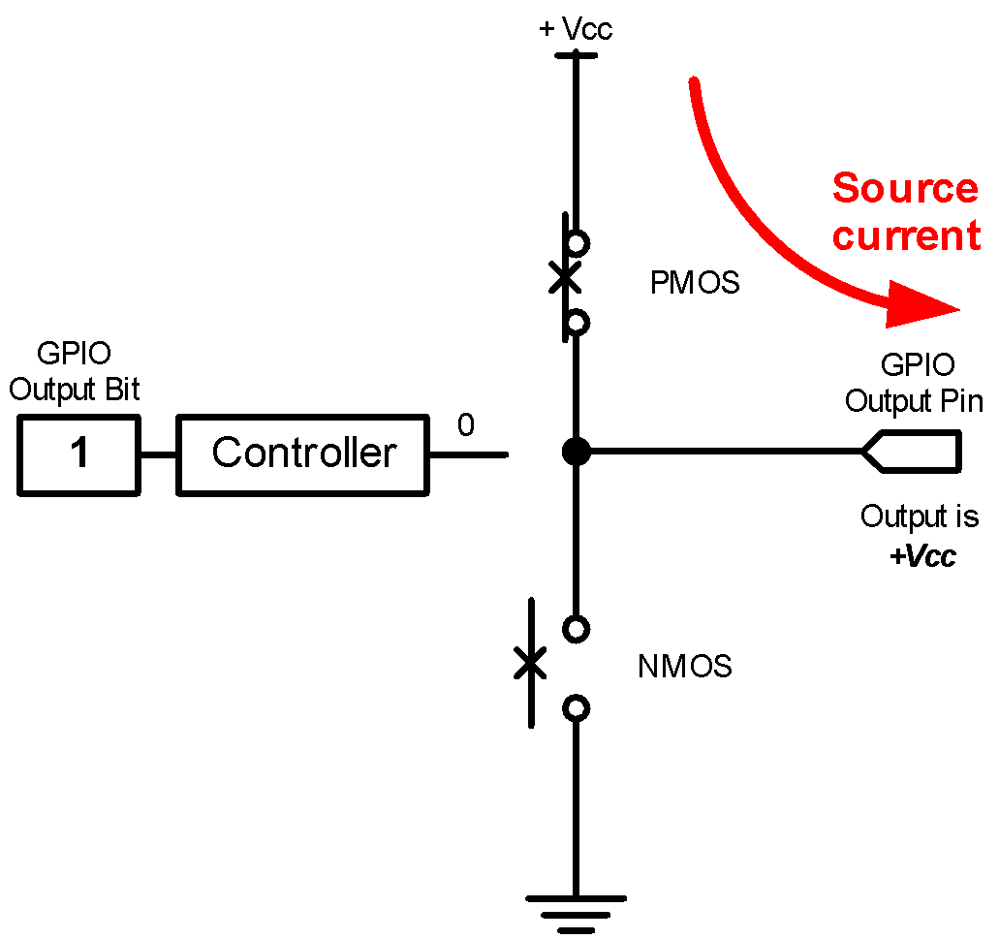
GPIO Output: Push-Pull
GPIO Output = 1
Source current to external circuit

Slide 23
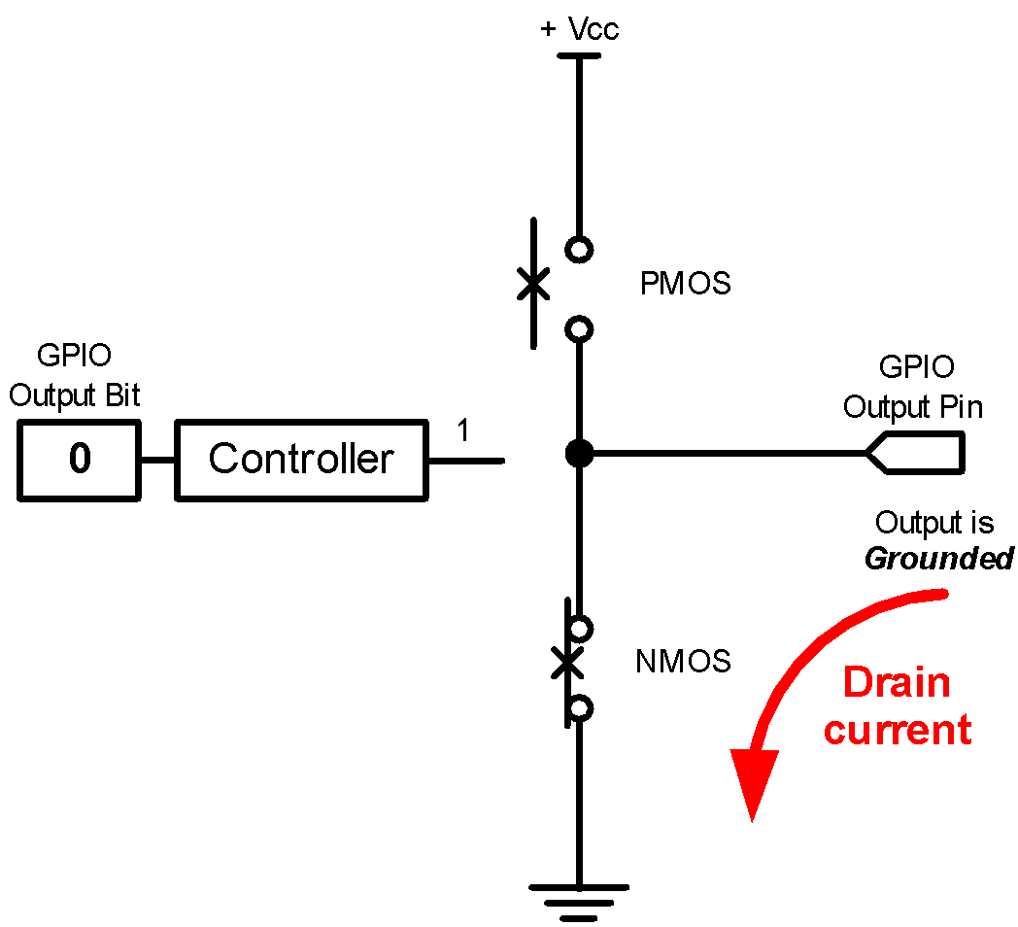
GPIO Output: Push-Pull
GPIO Output = 0
Drain current from external circuit

Slide 24
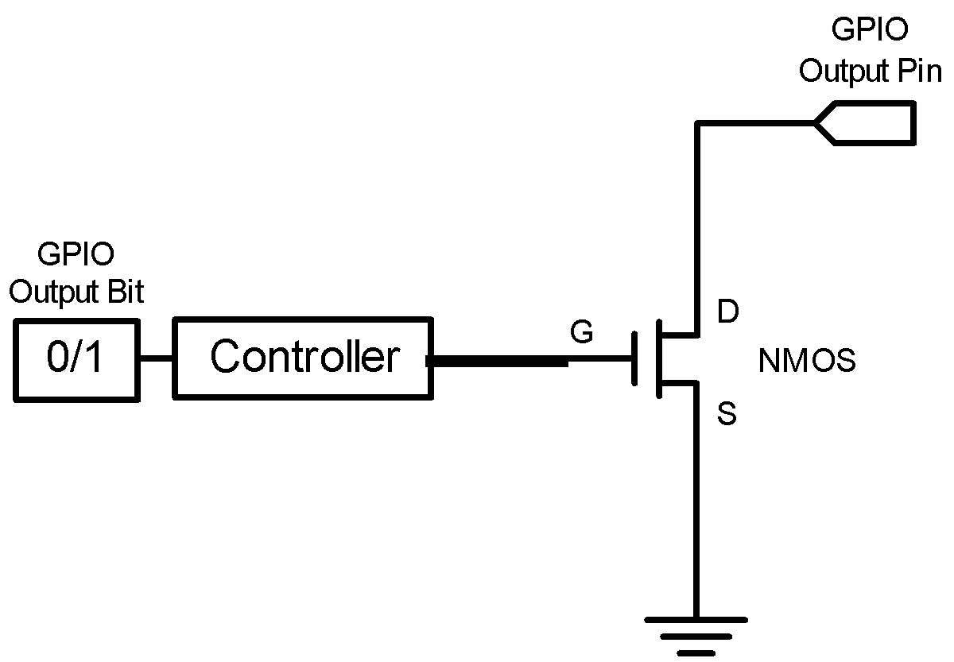
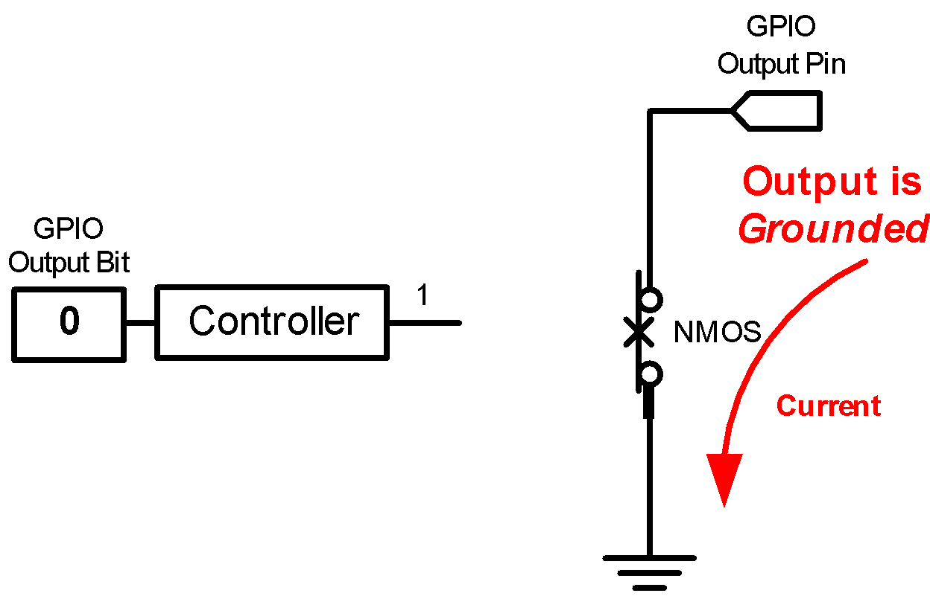
GPIO Output: Open-Drain
GPIO Output = 0
Drain current from external circuit

Slide 25
END OF CLASS

